Slide 1
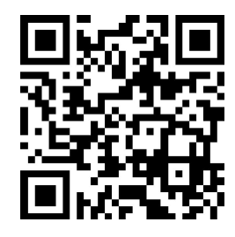
LEADER COMMUNICATION TOOLKIT
What’s the why?
Why is this important to our people? To our business? How is this part of our vision / mission / purpose / strategy? This is the storytelling part – the most important part. Include a strong first line and then provide them with key messages, why, rationale and make it engaging to them.
Who is the audience?
Ensure you’re crystal clear on the audience and who they are, what their jobs look like, their lives, how they connect / communicate. Who really are they? How can you stand in their shoes?
What’s in it for your audience / people?
If you’re not telling me what’s in it for me, I’m not listening! Tell people what this means for them, their lives, their work, their purpose.
.
Know
Do
Say
List what info they need to know
Summarise key things and provide links to further info
Ensure what they need to know is clear, concise, compelling
What action do you need them to take?
Spell it out very clearly and with timelines
Consider – if they only did one thing what would you want that to be?
Only give them 1-3 five-minute actions or it won’t happen
What are the messages they need to deliver?
Individually or at a team meeting?
How can they advocate?
What channels do you want them to use?
Be sure to give them educational, engaging and exciting messages
Include QR code or links to the intranet or teams' info on this initiative.
Detail here if it is confidential and their contact.
Kim Tunbridge

Slide 2
STEPS TO FOLLOW FOR THIS TOOLKIT
These are my hints and tips – I’d love to hear yours!
1
2
3
4
Your change / project
Collaborate to generate
Feedback / user testing
Rollout approach
Consider an imminent change – new system, results, financial change, inclusion event, restructure, new recognition scheme – whatever it is select one
Complete the template collaboratively – working with all key stakeholders and ensuring that legal / HR / PM / regulatory sign off if needed
Send the toolkit to a handful of leaders who are your ‘change champions’ and send it to one or two more cynical leaders too for feedback and incorporate feedback
Rollout to all leaders through the channels they use (meet them where they are comms approach). But load it onto the channels they don’t use and then provide a link through the channels they do. E.g. If they don’t use your intranet but use email, load it onto the intranet and then email them the link and the summary of the toolkit and benefits to them

